Slide 1

WELLCOME TO
OUR
PRESENTATION

Slide 2








Green University Of Bangladesh
DEPARTMENT OF COMPUTER SCIENCE AND ENGINEERING(CSE)
FACULTY OF SCIENCE AND ENGINEERING
Course Title: Chemistry Lab
Course Code: CHE-102
Section: PC-222 (DC)
Course Instructor :
Presented to Prasenjit Bhowmik
Lecturer, Dept of Textile, Green University Of Bangladesh
Group Members :
Md. Mahim Hossain
Manik Biswas
ID : 221902082
ID : 222902088
Md. Abu Saeid
Nuren Abreshum Anonta
ID : 221902092
ID : 222902092

Slide 3



EXPERIMENT NAME :
Standardization of Hydrochloric Acid with Standard Sodium Carbonate Solution

Slide 4





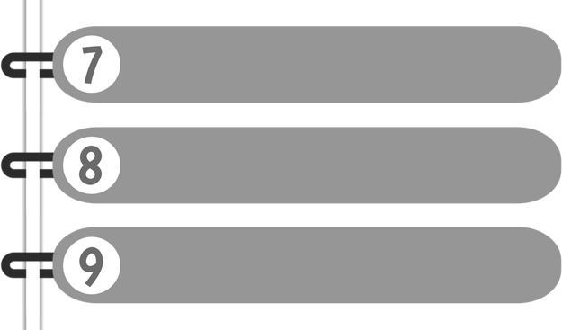


PRESENTATION OUTLINE
INTRODUCTION
THEORY
INDICATOR
APPARATUS
CHEMICALS USED
PROCEDURE
DATA TABLE
CALCULATION & RESULT
CONCLUSION

Slide 5


INTRODUCTION
We will standardize a solution of hydrochloric acid by titrating it against a solution of sodium carbonate.

Slide 6
THEORY
we shall determine the strength of commercial Hydrochloric Acid solution by a
secondary standard solution of Na2CO3.

Slide 7
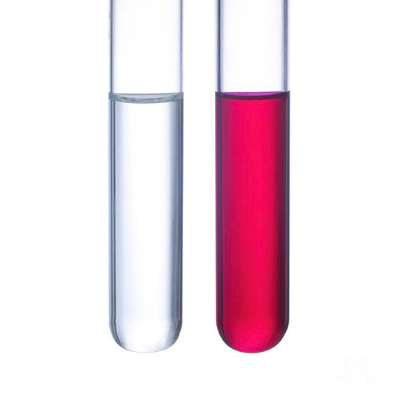
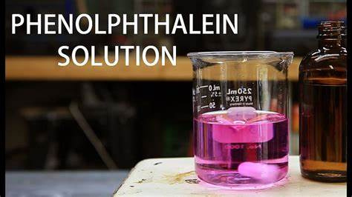
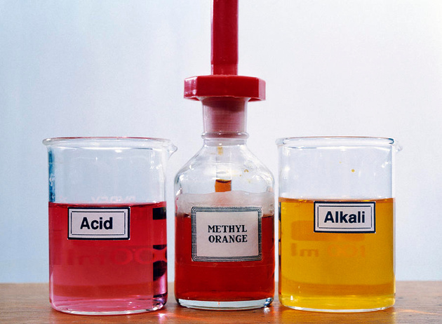
INDICATOR

Slide 8
APPARATUS
1. Conical flask
2. Burette
3. Pipette
4. Volumetric flask
5. Stand
6. Funnel

Slide 9
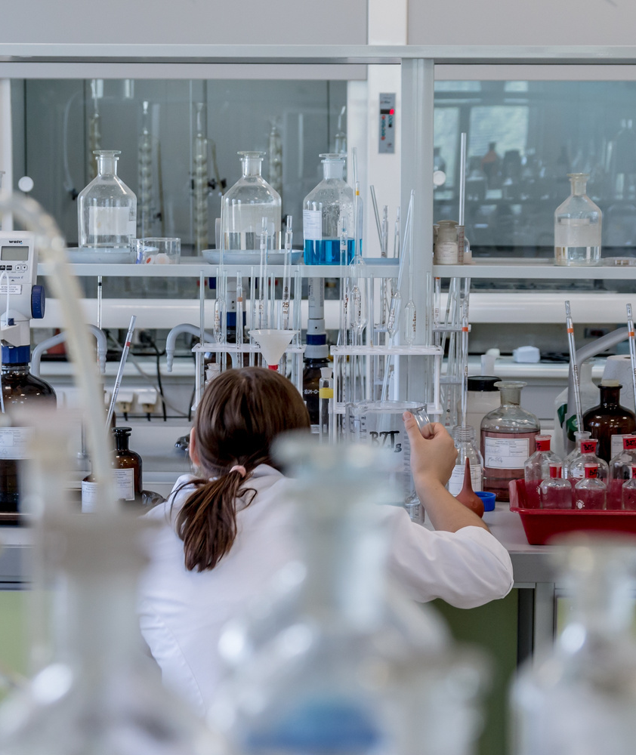
CHEMICALS USED
DON'T EAT INSIDE.
In this experiment we use
Standardized Na2CO3 solution
HCl solution
Distilled water

Slide 10
PROCEDURE
Prepare a 100 ml solution of Na2CO3 in a volumetric flask.
Take 10 ml of the solution in a conical flask and dilute it to 50 ml.
Add one drop of phenolphthalein to the solution and titrate against HCl using a burette.
Note the burette reading when the pink color of the solution just disappears. This is the first endpoint.
Add 3-4 drops of methyl orange to the same flask and continue titration against the same HCl.
Note the burette reading when the yellow color just changes to faint pink (orange). This is the second endpoint.
The difference in burette readings between the initial and second endpoints gives the volume of acid required for the titration.
Repeat the experiment twice and ensure that the results agree within ±0.1 ml initial to second endpoint.
Calculate the strength of the dilute HCl.
Determine the normality of the commercial conc. HCl acid.

Slide 11

EXPERIMENTAL DATA TABLE
No. of Obs . | Volum e of Na2C O3 in (ml) | Burette Reading in (ml) | Burette Reading in (ml) | Burette Reading in (ml) | Volume of Acid in (ml) | Average reading in (ml)
No. of Obs . | Volum e of Na2C O3 in (ml) | Initial readin g | 1st end point | 2nd end point | Volume of Acid in (ml) | Average reading in (ml)
1 | 10 | 8 | 13.1 | 18.7 | 10.7
2 | 10 | 18.7 | 24 | 29.7 | 11 | 10.77
3 | 10 | 29.7 | 34.4 | 40.3 | 10.6

Slide 12
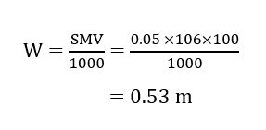
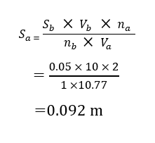
CALCULATION
Determination of the molarity of HCl :-

Slide 13
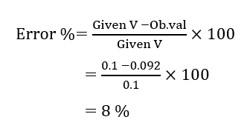
RESULT
The strength of the supplied HCl is: 0.092 m
ERROR

Slide 14
CONCLUSION
Standardization of hydrochloric acid with standard sodium carbonate solution is a useful analytical chemistry technique for determining the concentration of an acid solution. By using a known concentration of the sodium carbonate solution and performing a titration with the hydrochloric acid solution, the concentration of the hydrochloric acid solution can be accurately calculated.

Slide 15
THANK YOU FOR LISTENING!

Slide 16

ANY QUESTION ?

